Slide 2

The Gospels change us from the inside out
Newness of life (Rom 6:4)
New self (Eph 4:24)
Renewed mind (Rom 12:2)

Slide 3

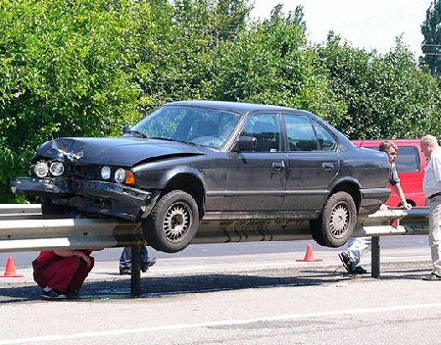
Guardrails
Hitting guardrails will cause some damage, but it keeps you from destroying your life

Slide 4



God’s guardrails
God’s guardrails keep us from ruining our lives

Slide 5

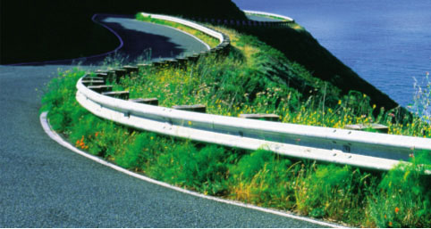

Slide 6

Proverbs 27:12 The prudent see danger and take refuge, but the simple keep going and pay the penalty. (NIV)

Slide 7

Guardrails Around Relationships

Slide 8

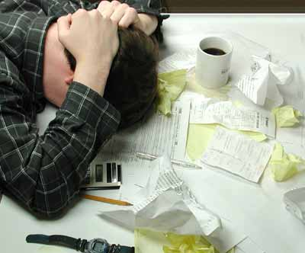
Guardrails Around Finances

Slide 9

Guardrails Around Our Attitudes
Attitude

Slide 10

Emerson: “What lies behind us and what lies before us are tiny matters compared to what lies within us”

Slide 11

1. God is concerned about your attitude
Luke 10:27 And he answered, “YOU SHALL LOVE THE LORD YOUR GOD WITH ALL YOUR HEART, AND WITH ALL YOUR SOUL, AND WITH ALL YOUR STRENGTH, AND WITH ALL YOUR MIND; AND YOUR NEIGHBOR AS YOURSELF.”

Slide 12
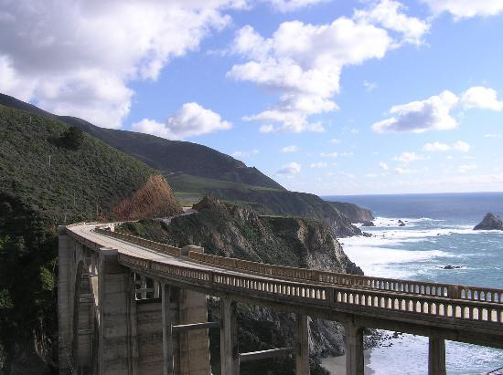
2 Corinthians 9:7 Each one must do just as he has purposed in his heart, not grudgingly or under compulsion, for God loves a cheerful giver.
Colossians 3:16 Let the word of Christ richly dwell within you, with all wisdom teaching and admonishing one another with psalms and hymns and spiritual songs, singing with thankfulness in your hearts to God.

Slide 13
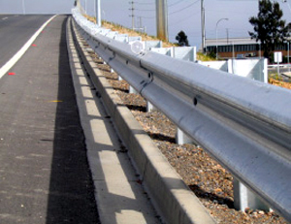
1 Peter 2:2 like newborn babies, long for the pure milk of the word, so that by it you may grow in respect to salvation,
James 5:16 Confess your faults one to another, and pray one for another, that ye may be healed. The effectual fervent prayer of a righteous man availeth much.

Slide 14

Hebrews 13:17 Obey your leaders and submit to them, for they keep watch over your souls as those who will give an account. Let them do this with joy and not with grief, for this would be unprofitable for you.

Slide 15


1 Corinthians 10:10 Nor grumble, as some of them did, and were destroyed by the destroyer

Slide 16
Philippians 2:4 do not merely look out for your own personal interests, but also for the interests of others.
A
T
T
I
T
U
D
E
Romans 12:3 For through the grace given to me I say to everyone among you not to think more highly of himself than he ought to think; but to think so as to have sound judgment, as God has allotted to each a measure of faith.

Slide 17

Luke 18:9 And He also told this parable to some people who trusted in themselves that they were righteous, and viewed others with contempt:
A
T
T
I
T
U
D
E
Luke 18:2 saying, “In a certain city there was a judge who did not fear God and did not respect man.

Slide 18

A
T
T
I
T
U
D
E
Galatians 5:19-21 Now the deeds of the flesh are evident, which are: immorality, impurity, sensuality, idolatry, sorcery, enmities, strife, jealousy, outbursts of anger, disputes, dissensions, factions, envying, drunkenness, carousing, and things like these, of which I forewarn you, just as I have forewarned you, that those who practice such things will not inherit the kingdom of God.

Slide 19


2. Your attitude is the lens of your life
Proverbs 23:7 For as he thinks within himself, so he is

Slide 20

2. Your attitude is the lens of your life
It reveals the real you
It shows others what is important to you
It is the greatest factor in determining success or failure in all you do
It effects all of your relationships

Slide 21

3. Your attitude is effected by outside influences

Slide 22

Phil 4:8 Finally, brethren, whatever is true, whatever is honorable, whatever is right, whatever is pure, whatever is lovely, whatever is of good repute, if there is any excellence and if anything worthy of praise, let your mind dwell on these things.

Slide 23

4. Your attitude is always your choice

Slide 24

5. There are five factors that can crash your attitude
fear
discouragement
sin
negativism
problems

Slide 25
God’s Guardrail: Learn from Jesus
Matthew 11:28-30 "Come to Me, all who are weary and heavy-laden, and I will give you rest. "Take My yoke upon you, and learn from Me, for I am gentle and humble in heart; and YOU SHALL FIND REST FOR YOUR SOULS."For My yoke is easy, and My load is light.“

Slide 26

Humility
Humility is not…
low self esteem
putting self down
something that can be turned on or off
being poor
simply being tolerant
silence

Slide 27

Humility
Greek word Humus: means ‘earth’ (low)
Humbleness moves God (James 4:6-10)

Slide 28

The opposite of humility is pride
Pride breeds independence
Pride blinds us to others
Pride covers up
Pride is more interested in image than doing right
Pride has difficulty forgiving

Slide 29
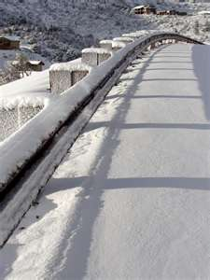
Attitude guardrails:
Dump the junk that spoils a good attitude
Start thinking, speaking and doing positively

Slide 30

Ephesians 4:32 Be kind to one another, tender-hearted, forgiving each other, just as God in Christ also has forgiven you.
Proverbs 31:25 Strength and dignity are her clothing, and she smiles at the future.

Slide 31

Attitude guardrails:
Dump the junk that spoils a good attitude
Start thinking, speaking and doing positively
No matter what happens, look for good

Slide 32

2 Corinthians 4:7-10 But we have this treasure in earthen vessels, so that the surpassing greatness of the power will be of God and not from ourselves; we are afflicted in every way, but not crushed; perplexed, but not despairing; persecuted, but not forsaken; struck down, but not destroyed; always carrying about in the body the dying of Jesus, so that the life of Jesus also may be manifested in our body

Slide 33

Attitude guardrails:
Fix your attention to Jesus
Psalm 34:3 O magnify the LORD with me, And let us exalt His name together.

Slide 34
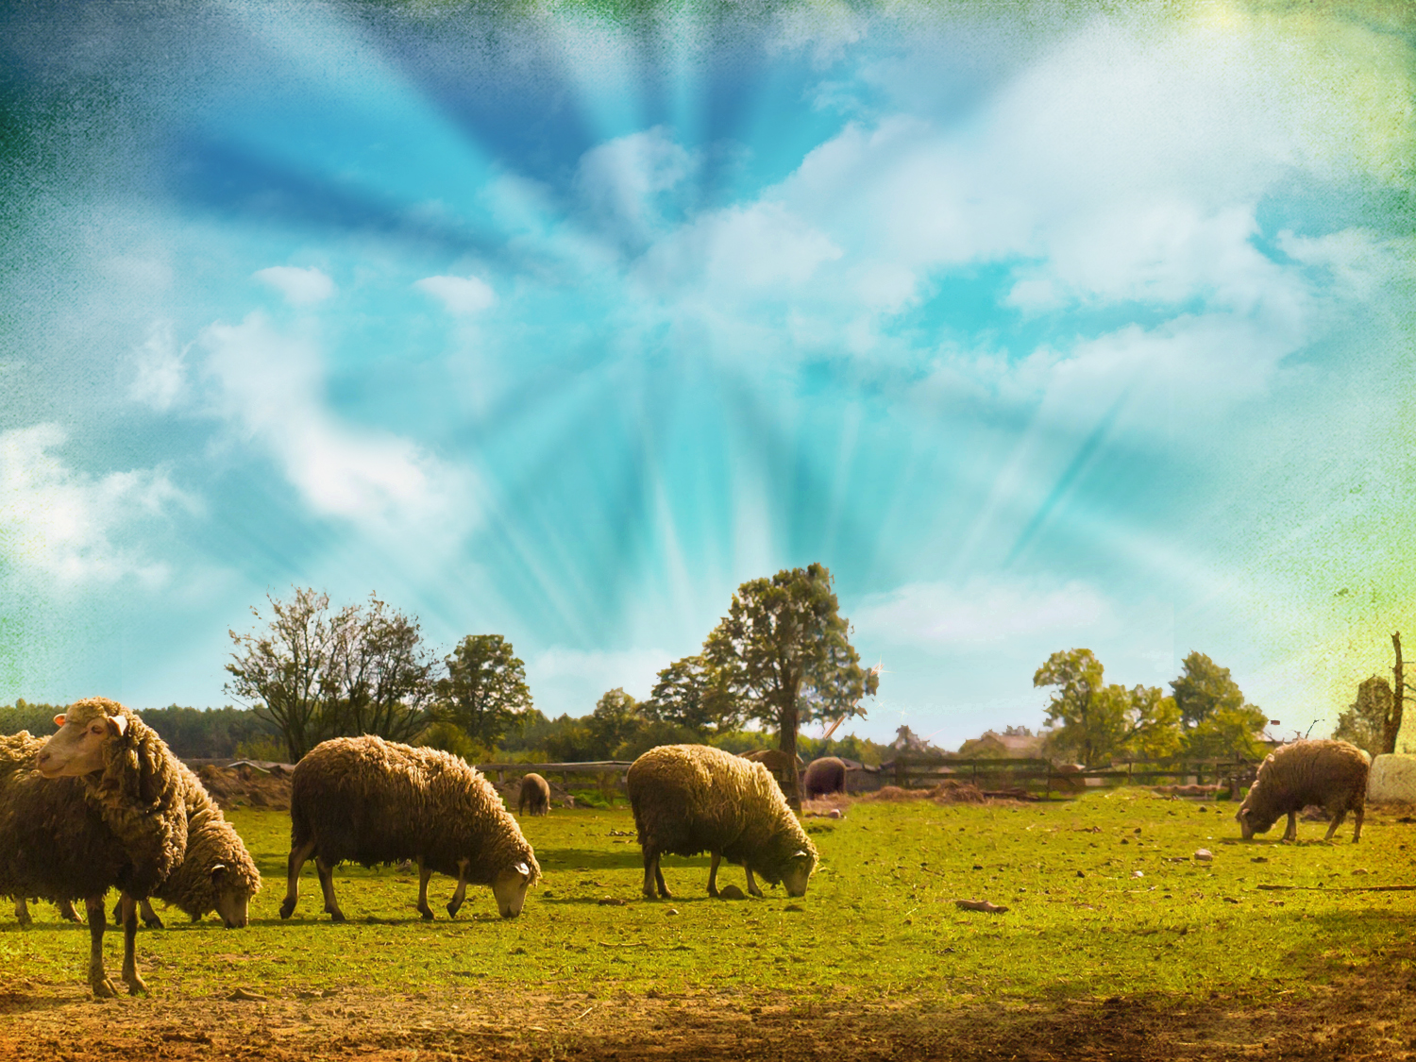
Attitude guardrails:
Dump the junk that spoils a good attitude
Start thinking, speaking and doing positively
No matter what happens, look for good
Fix your attention to Jesus
Develop a heart that makes you a team player

Slide 35
God’s guardrails
God’s guardrails keep us from ruining our lives

